Slide 1

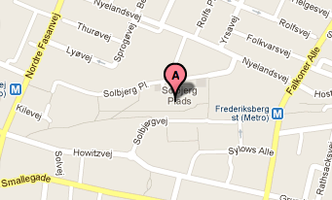
Hotel Radisson Blue
A
Solbjerg Plads: Lunch
Kilevej 14: Workshop site
IT building, Howitzvej 60: “Get Together”

